Slide 1
CS 152 Computer Architecture and Engineering CS252 Graduate Computer Architecture Lecture 16 GPUs (Graphics Processing Units)
Krste Asanovic
Electrical Engineering and Computer Sciences
University of California at Berkeley
http://www.eecs.berkeley.edu/~krste
http://inst.eecs.berkeley.edu/~cs152

Slide 2
Last Time in Lecture 15
Vector supercomputers
Vector register versus vector memory
Scaling performance with lanes
Stripmining
Chaining
Masking
Scatter/Gather

Slide 3
Types of Parallelism
Instruction-Level Parallelism (ILP)
Execute independent instructions from one instruction stream in parallel (pipelining, superscalar, VLIW)
Thread-Level Parallelism (TLP)
Execute independent instruction streams in parallel (multithreading, multiple cores)
Data-Level Parallelism (DLP)
Execute multiple operations of the same type in parallel (vector/SIMD execution)
Which is easiest to program?
Which is most flexible form of parallelism?
i.e., can be used in more situations
Which is most efficient?
i.e., greatest tasks/second/area, lowest energy/task

Slide 4
Resurgence of DLP
Convergence of application demands and technology constraints drives architecture choice
New applications, such as graphics, machine vision, speech recognition, machine learning, etc. all require large numerical computations that are often trivially data parallel
SIMD-based architectures (vector-SIMD, subword-SIMD, SIMT/GPUs) are most efficient way to execute these algorithms

Slide 5
Packed SIMD Extensions
64b
32b
32b
16b
16b
16b
16b
8b
8b
8b
8b
8b
8b
8b
8b
Short vectors added to existing microprocessors ISAs, for multimedia
Use existing 64-bit registers split into 2x32b or 4x16b or 8x8b
Lincoln Labs TX-2 from 1957 had 36b datapath split into 2x18b or 4x9b
Newer designs have wider registers
128b for PowerPC Altivec, Intel SSE2/3/4
256b for Intel AVX
Single instruction operates on all elements within register
16b
16b
16b
16b
16b
16b
16b
16b
4x16b adds
+
+
+
+
16b
16b
16b
16b

Slide 6
Multimedia Extensions versus Vectors
Limited instruction set
no vector length control
no strided load/store or scatter/gather
unit-stride loads must be naturally aligned to whole register width (e.g., 64 or 128-bit)
Limited vector register length
requires superscalar issue to keep multiply/add/load units busy
loop unrolling to hide latencies increases register pressure
Trend towards fuller vector support in microprocessors
Better support for misaligned memory accesses
Support of double-precision (64-bit floating-point)
New Intel AVX spec (announced April 2008), 256b vector registers (expandable up to 1024b) , adding scatter/gather
New ARM SVE/MVE vector ISA closer to traditional vector designs

Slide 7
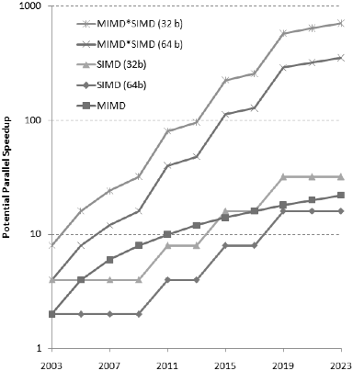
DLP important for conventional CPUs
Prediction for x86 processors, from Hennessy & Patterson, 5th edition
Note: Educated guess, not Intel product plans!
TLP: 2+ cores / 2 years
DLP: 2x width / 4 years
DLP will account for more mainstream parallelism growth than TLP in next decade.
SIMD –single-instruction multiple-data (DLP)
MIMD- multiple-instruction multiple-data (TLP)

Slide 8
Graphics Processing Units (GPUs)
Original GPUs were dedicated fixed-function devices for generating 3D graphics (mid-late 1990s) including high-performance floating-point units
Provide workstation-like graphics for PCs
User could configure graphics pipeline, but not really program it
Over time, more programmability added (2001-2005)
E.g., New language Cg for writing small programs run on each vertex or each pixel, also Windows DirectX variants
Massively parallel (millions of vertices or pixels per frame) but very constrained programming model
Some users noticed they could do general-purpose computation by mapping input and output data to images, and computation to vertex and pixel shading computations
Incredibly difficult programming model as had to use graphics pipeline model for general computation

Slide 9
General-Purpose GPUs (GP-GPUs)
In 2006, Nvidia introduced GeForce 8800 GPU, which supported a new programming language CUDA (in 2007)
“Compute Unified Device Architecture”
Subsequently, broader industry pushing for OpenCL, a vendor-neutral version of same ideas.
Idea: Take advantage of GPU computational performance and memory bandwidth to accelerate some kernels for general-purpose computing
Attached processor model: Host CPU issues data-parallel kernels to GP-GPU for execution
This lecture has a simplified version of Nvidia CUDA-style model and only considers GPU execution for computational kernels, not graphics
Would need whole other course to describe graphics processing

Slide 10
Simplified CUDA Programming Model
Computation performed by a very large number of independent small scalar threads (CUDA threads or microthreads) grouped into thread blocks.
// C version of DAXPY loop.
void daxpy(int n, double a, double*x, double*y)
{ for (int i=0; i<n; i++)
y[i] = a*x[i] + y[i]; }
// CUDA version.
__host__ // Piece run on host processor.
int nblocks = (n+255)/256; //256 CUDA threads/block
daxpy<<<nblocks,256>>>(n,2.0,x,y);
__device__ // Piece run on GP-GPU.
void daxpy(int n, double a, double*x, double*y)
{ int i = blockIdx.x*blockDim.x + threadId.x;
if (i<n) y[i]=a*x[i]+y[i]; }

Slide 11
Programmer’s View of Execution
blockIdx 0
threadId 0
blockDim = 256 (programmer can choose)
threadId 1
threadId 255
blockIdx 1
threadId 0
Create enough blocks to cover input vector
(NVIDIA calls this ensemble of blocks a Grid, can be 2-dimensional)
threadId 1
threadId 255
blockIdx
(n+255/256)
threadId 0
Conditional (i<n) turns off unused threads in last block
threadId 1
threadId 255

Slide 12
Hardware Execution Model
GPU
CPU
Core 0
Core 1
Core 15
Lane 0
Lane 0
Lane 0
Lane 1
Lane 1
Lane 1
Lane 15
Lane 15
Lane 15
CPU Memory
GPU Memory
GPU is built from multiple parallel cores, each core contains a multithreaded SIMD processor with multiple lanes but with no scalar processor
some adding “scalar coprocessors” now
CPU sends whole “grid” over to GPU, which distributes thread blocks among cores (each thread block executes on one core)
Programmer unaware of number of cores

Slide 13
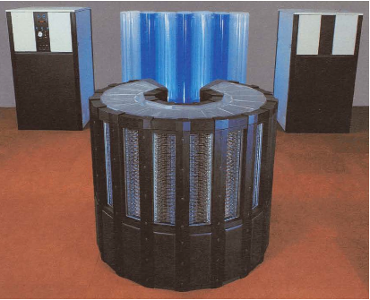
Historical Retrospective, Cray-2 (1985)
243MHz ECL logic
2GB DRAM main memory (128 banks of 16MB each)
Bank busy time 57 clocks!
Local memory of 128KB/core
1 foreground + 4 background vector processors
Core 0
Lane
Core 0
Lane
Core 0
Foreground CPU
Lane
Core 0
Local Memory
Lane
Local Memory
Local Memory
Local Memory
Shared Memory

Slide 14
“Single Instruction, Multiple Thread” (SIMT)
GPUs use a SIMT model, where individual scalar instruction streams for each CUDA thread are grouped together for SIMD execution on hardware (NVIDIA groups 32 CUDA threads into a warp)
µT0
µT1
µT2
µT3
µT4
µT5
µT6
µT7
ld x, (z)
Scalar instruction stream
mul a
ld y, (w)
add
st y, (w)
SIMD execution across warp

Slide 15
Implications of SIMT Model
All “vector” loads and stores are scatter-gather, as individual µthreads perform scalar loads and stores
GPU adds hardware to dynamically coalesce individual µthread loads and stores to mimic vector loads and stores
Every µthread has to perform stripmining calculations redundantly (“am I active?”) as there is no scalar processor equivalent

Slide 16
CS152 Administrivia
PS 4 and Lab 3 due Monday April 5
Lab 4 out on Wednesday March 31
Special Announcement, Project Prizes!
Apple donating specially engraved Airpod Pro as prizes
Awarded to top two teams in open-ended portions of labs 3,4,5

Slide 17
CS252 Administrivia
This week’s readings: Branch Prediction
Project prize, sponsored by Apple
Top team receives engraved Airpod Pros

Slide 18
Conditionals in SIMT model
Simple if-then-else are compiled into predicated execution, equivalent to vector masking
More complex control flow compiled into branches
How to execute a vector of branches? Vector function calls?
µT0
µT1
µT2
µT3
µT4
µT5
µT6
µT7
tid=threadid
Scalar instruction stream
If (tid >= n) skip
Call func1
add
st y
skip:
SIMD execution across warp

Slide 19
Branch Divergence
Hardware tracks which µthreads take or don’t take branch
If all go the same way, then keep going in SIMD fashion
If not, create mask vector indicating taken/not-taken
Keep executing not-taken path under mask, push taken branch PC+mask onto a hardware stack and execute later
When can execution of µthreads in warp reconverge?

Slide 20
NVIDIA Instruction Set Arch.
ISA is an abstraction of the hardware instruction set
“Parallel Thread Execution (PTX)”
opcode.type d,a,b,c;
Uses virtual registers
Translation to machine code is performed in software
Example:
shl.s32 R8, blockIdx, 9 ; Thread Block ID * Block size (512 or 29)
add.s32 R8, R8, threadIdx ; R8 = i = my CUDA thread ID
ld.global.f64 RD0, [X+R8] ; RD0 = X[i]
ld.global.f64 RD2, [Y+R8] ; RD2 = Y[i]
mul.f64 R0D, RD0, RD4 ; Product in RD0 = RD0 * RD4 (scalar a)
add.f64 R0D, RD0, RD2 ; Sum in RD0 = RD0 + RD2 (Y[i])
st.global.f64 [Y+R8], RD0 ; Y[i] = sum (X[i]*a + Y[i])
Graphical Processing Units

Slide 21
Conditional Branching
Like vector architectures, GPU branch hardware uses internal masks
Also uses
Branch synchronization stack
Entries consist of masks for each SIMD lane
I.e. which threads commit their results (all threads execute)
Instruction markers to manage when a branch diverges into multiple execution paths
Push on divergent branch
…and when paths converge
Act as barriers
Pops stack
Per-thread-lane 1-bit predicate register, specified by programmer
Graphical Processing Units

Slide 22
Example
if (X[i] != 0)
X[i] = X[i] – Y[i];
else X[i] = Z[i];
ld.global.f64 RD0, [X+R8] ; RD0 = X[i]
setp.neq.s32 P1, RD0, #0 ; P1 is predicate register 1
@!P1, bra ELSE1, *Push ; Push old mask, set new mask bits
; if P1 false, go to ELSE1
ld.global.f64 RD2, [Y+R8] ; RD2 = Y[i]
sub.f64 RD0, RD0, RD2 ; Difference in RD0
st.global.f64 [X+R8], RD0 ; X[i] = RD0
@P1, bra ENDIF1, *Comp ; complement mask bits
; if P1 true, go to ENDIF1
ELSE1: ld.global.f64 RD0, [Z+R8] ; RD0 = Z[i]
st.global.f64 [X+R8], RD0 ; X[i] = RD0
ENDIF1: <next instruction>, *Pop ; pop to restore old mask
Graphical Processing Units

Slide 23
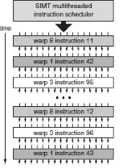
Warps are multithreaded on core
One warp of 32 µthreads is a single thread in the hardware
Multiple warp threads are interleaved in execution on a single core to hide latencies (memory and functional unit)
A single thread block can contain multiple warps (up to 512 µT max in CUDA), all mapped to single core
Can have multiple blocks executing on one core
[Nvidia, 2010]

Slide 24
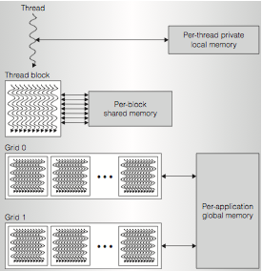
GPU Memory Hierarchy
[ Nvidia, 2010]

Slide 25
SIMT
Illusion of many independent threads
But for efficiency, programmer must try and keep µthreads aligned in a SIMD fashion
Try and do unit-stride loads and store so memory coalescing kicks in
Avoid branch divergence so most instruction slots execute useful work and are not masked off

Slide 26
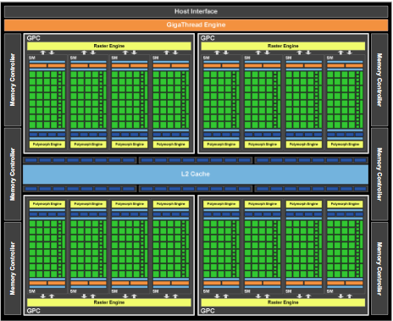
Nvidia Fermi GF100 GPU
[Nvidia, 2010]

Slide 27
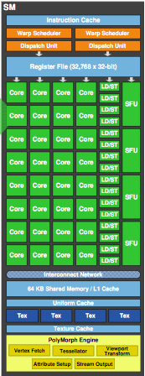
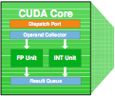
Fermi “Streaming Multiprocessor” Core

Slide 28
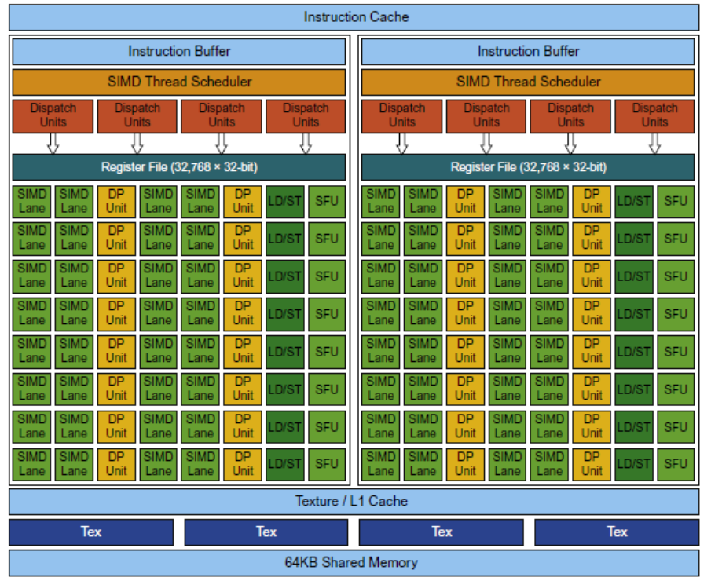
NVIDIA Pascal Multithreaded GPU Core

Slide 29
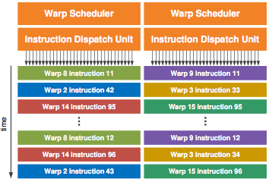
Fermi Dual-Issue Warp Scheduler

Slide 30
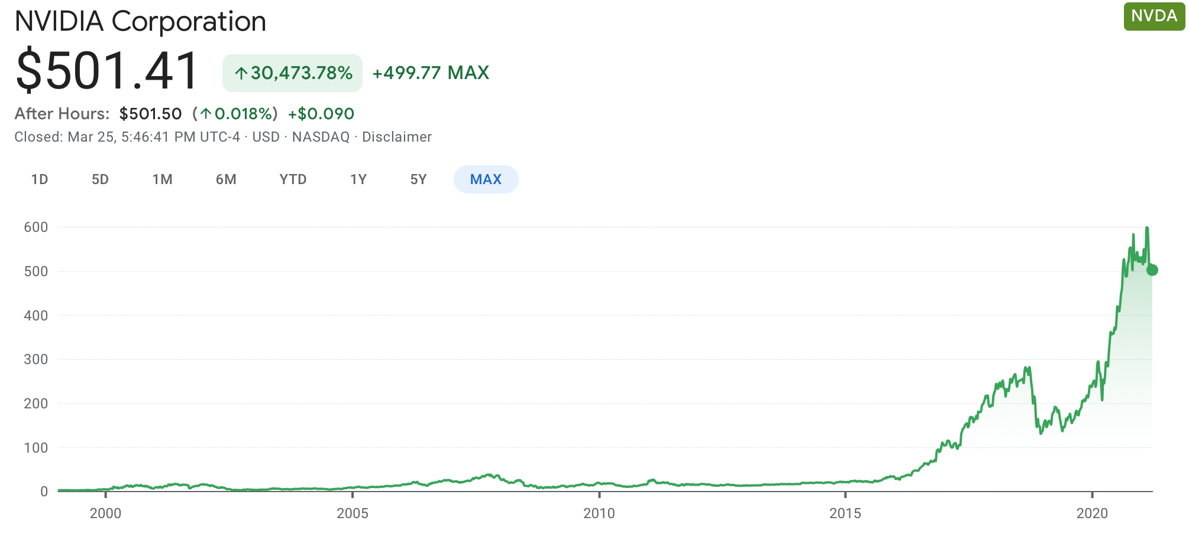
Important of Machine Learning for GPUs
NVIDIA stock price 40x in 9 years (since deep learning became important)

Slide 31
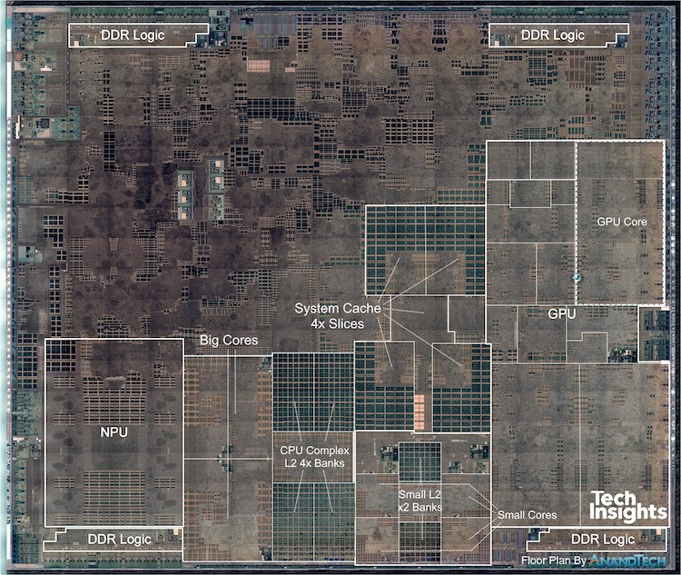
Apple A12 Processor (2018)
83.27mm²
7nm technology
[Source: Tech Insights, AnandTech]

